Slide 1


Slide 2

FONTS USED:
LOGO: ACLONICA
General: 42DOT SANS

Slide 3


Slide 4


Slide 5


Slide 6
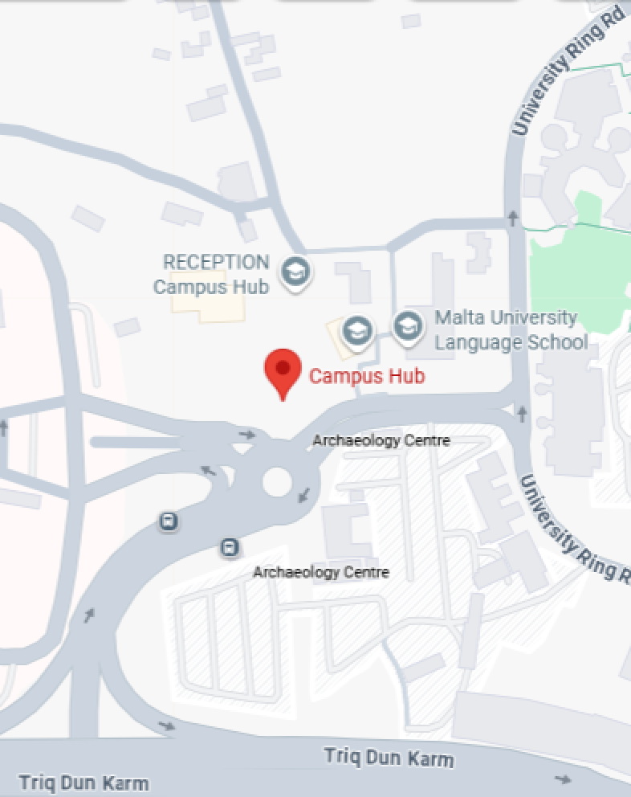

Slide 7
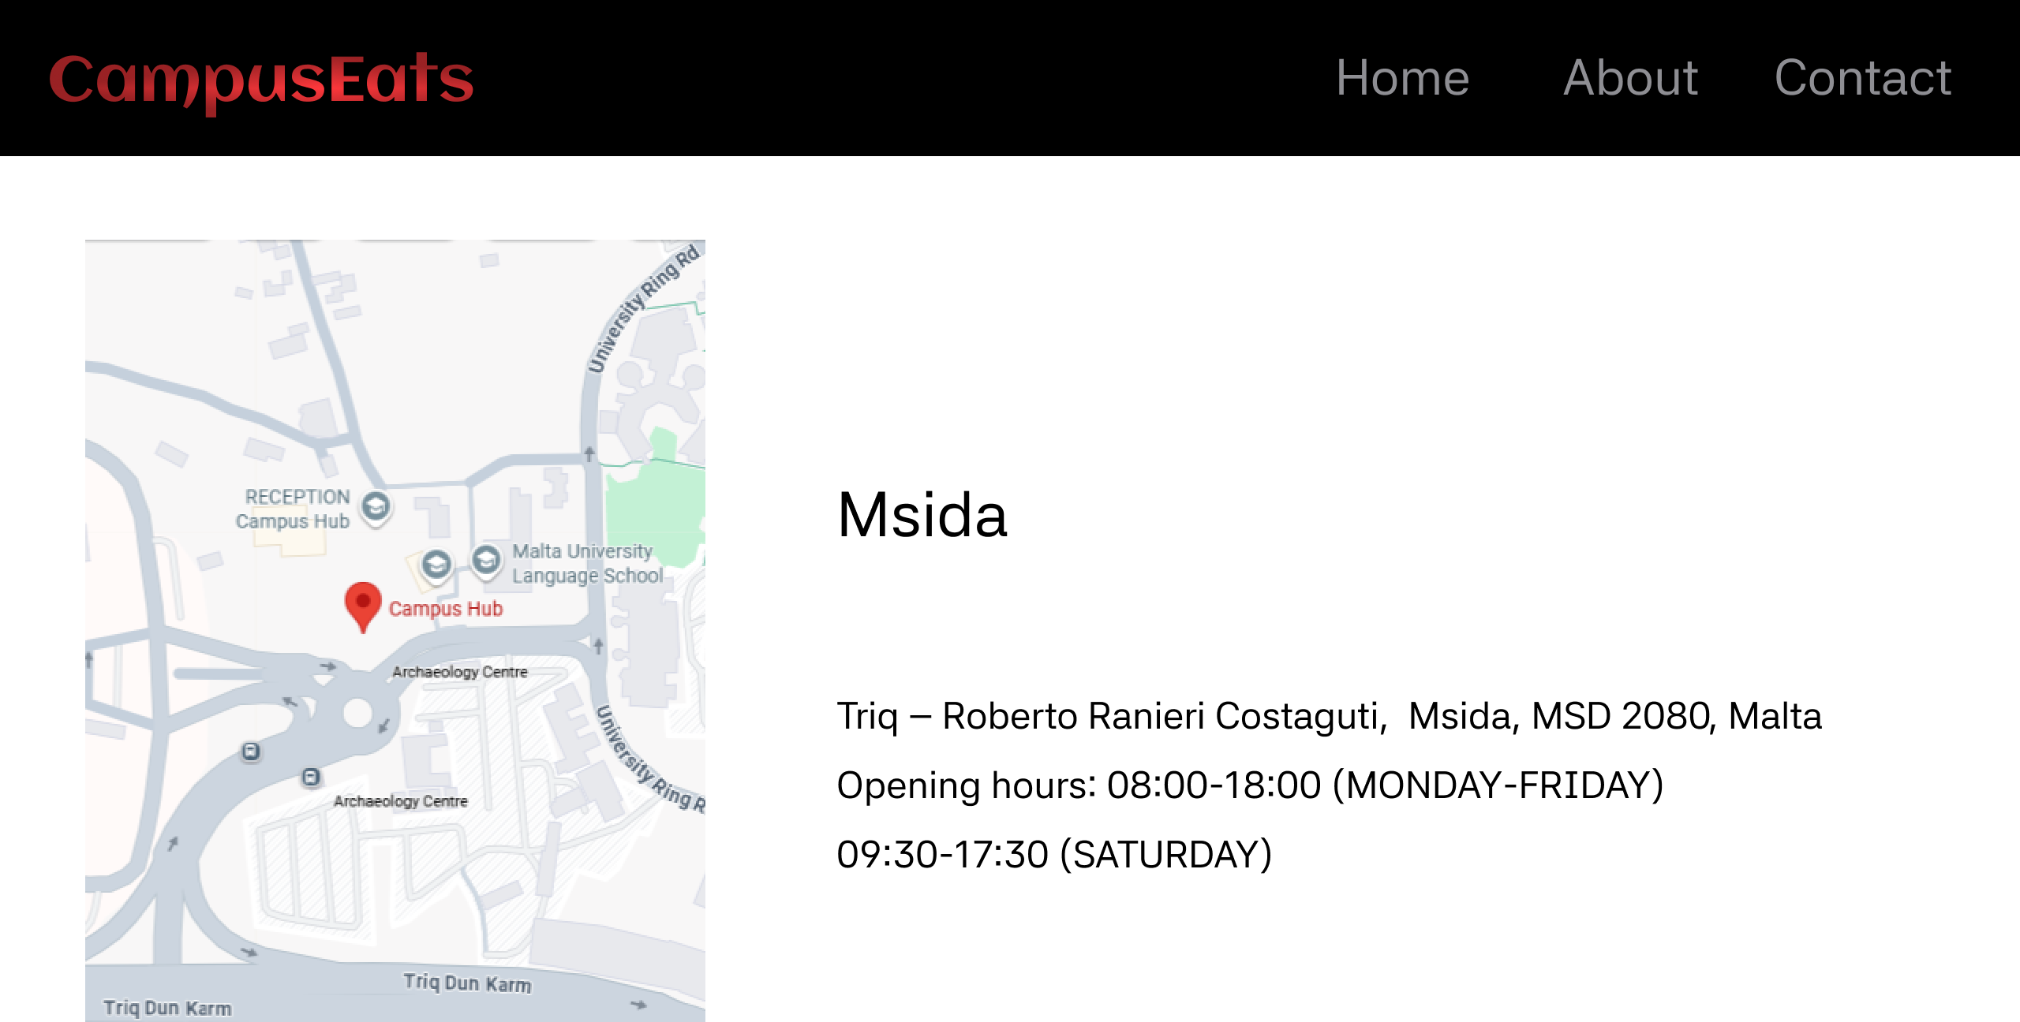

Slide 8


Slide 9
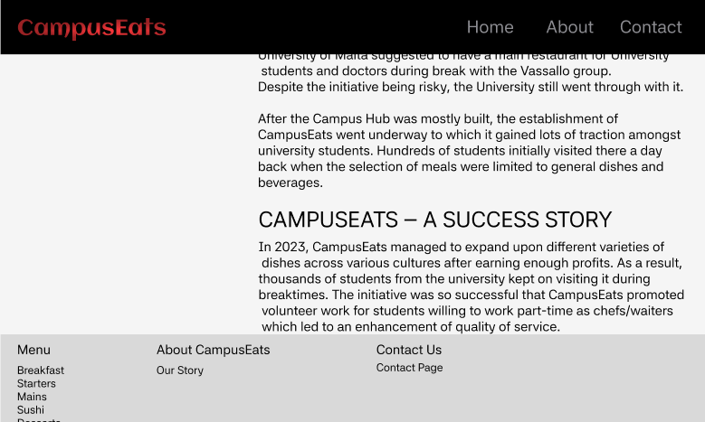

Slide 10
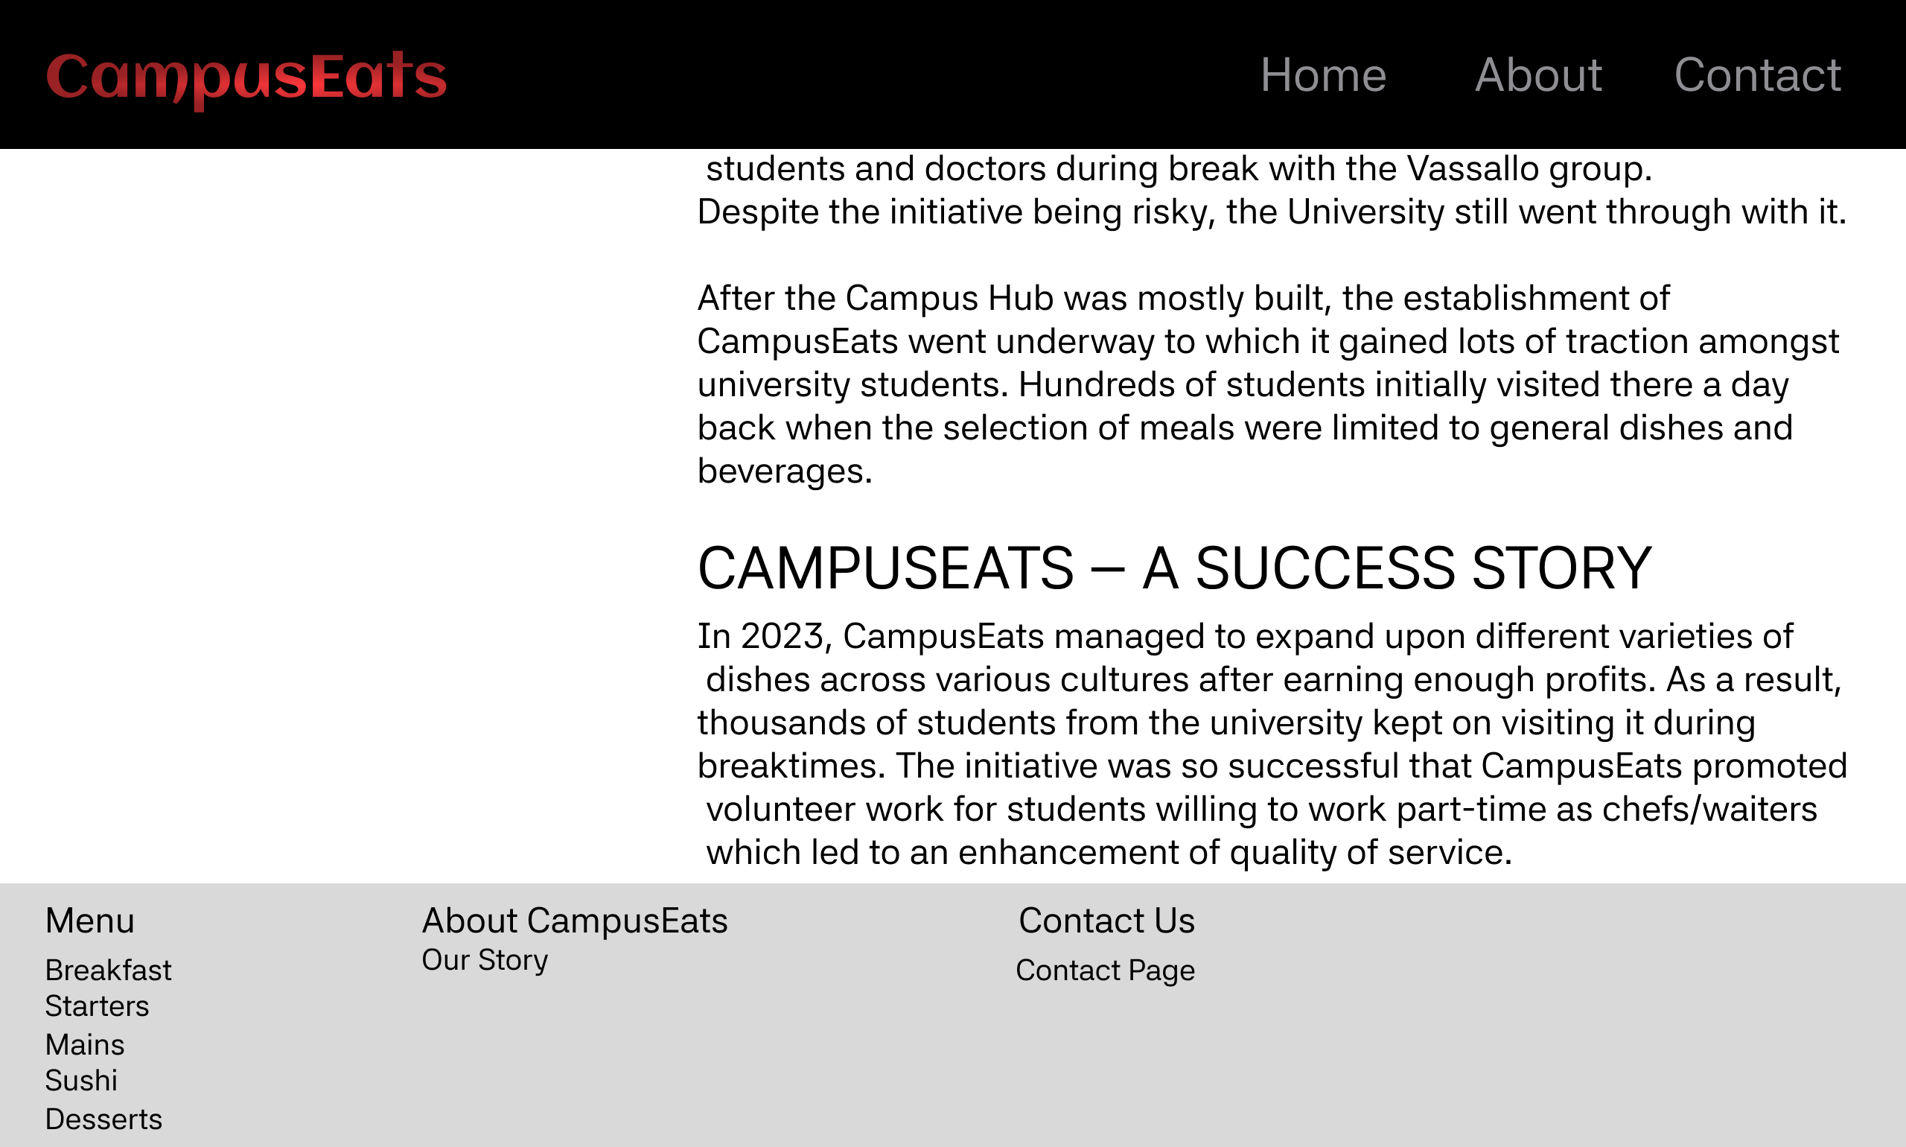

Slide 11
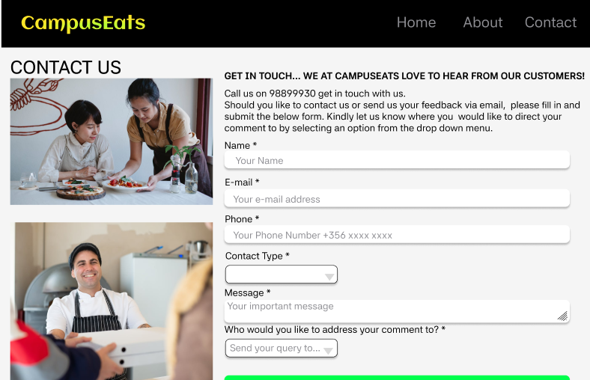

Slide 12


Slide 13


Slide 14
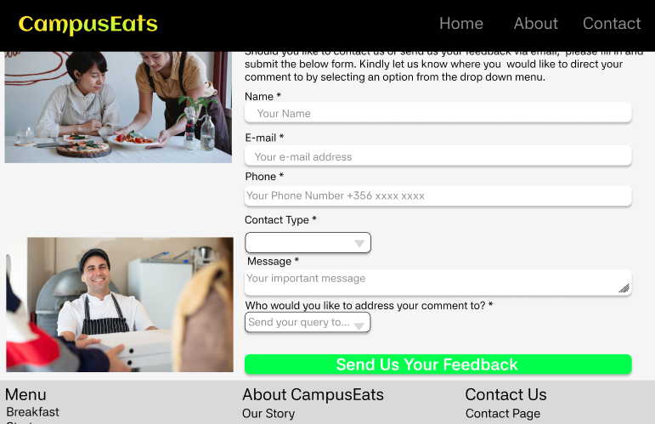

Slide 15


Slide 16
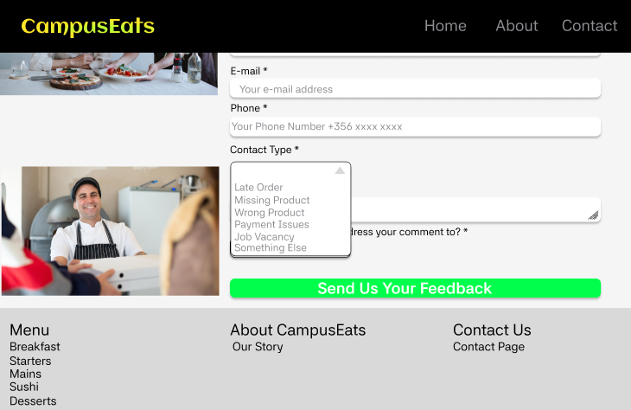

Slide 17
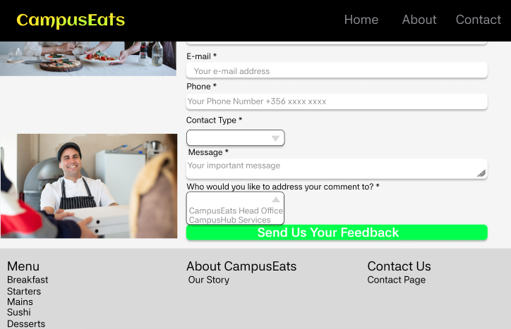

Slide 18
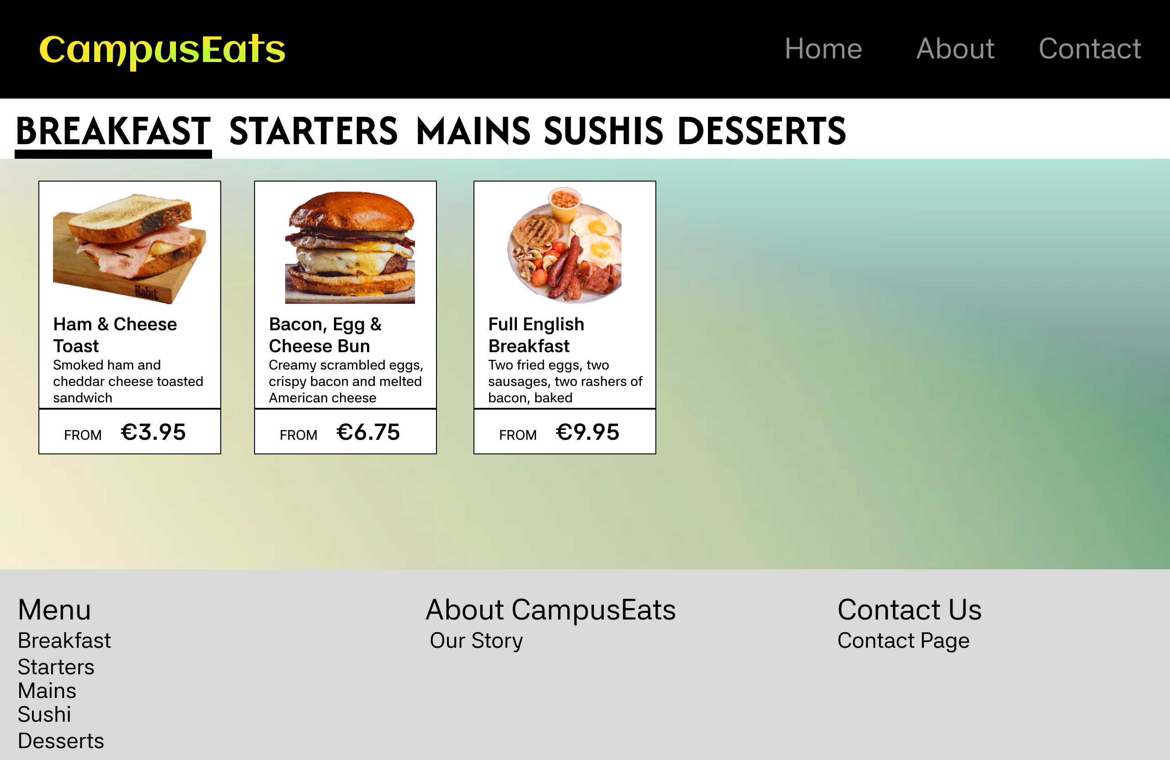

Slide 19

FONT USED:
AFACAD

Slide 20


Slide 21
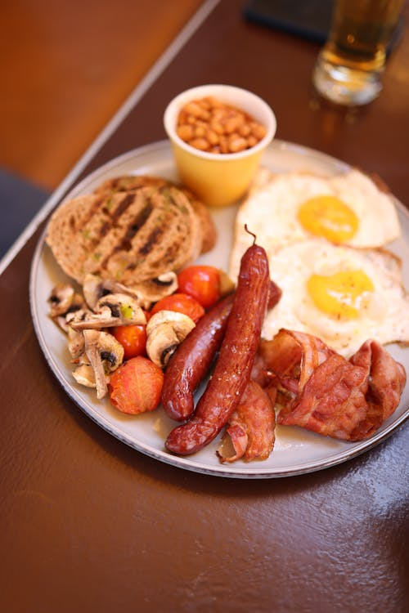

Slide 22


Slide 23
